Slide 1
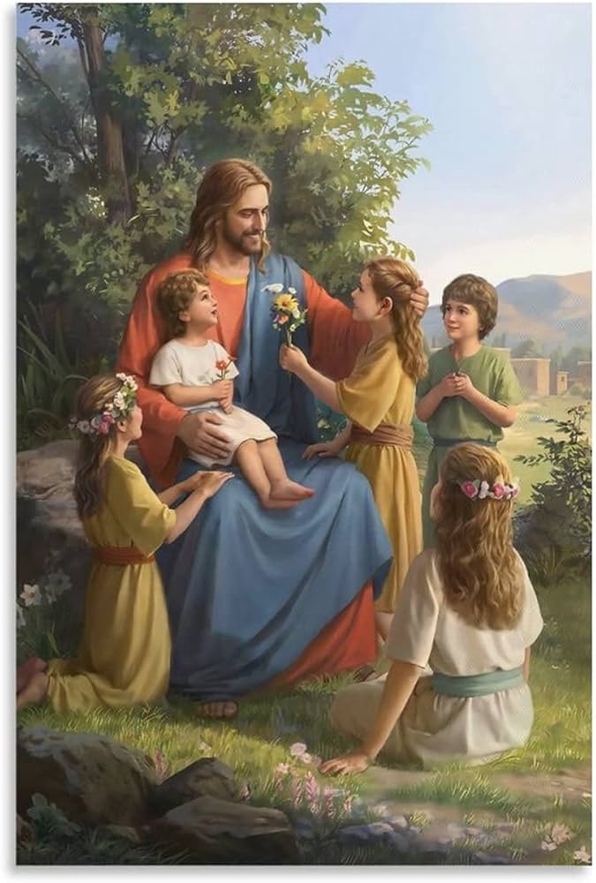
Jesus Loves the Little Children

Slide 2
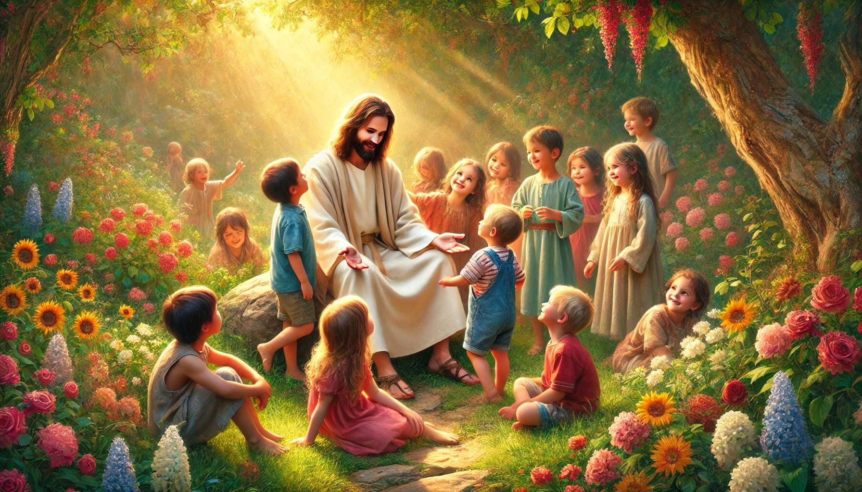
Let the Children Come to Jesus (Luke 18:15-16a)
Some people brought their small children to Jesus so that He could touch them. When the followers saw this, they told the people not to do this.

Slide 3
But Jesus called the little children to Him and said to His followers,
“Let the little children come to me. Don’t stop them.”

Slide 4
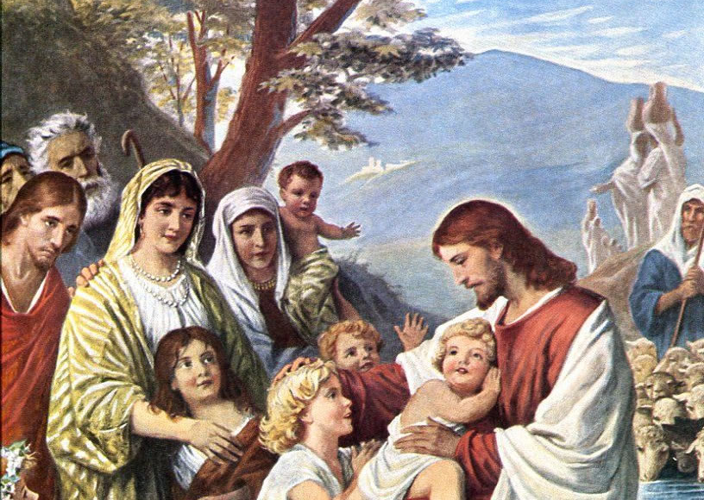
Bless Children (Mark 10:16)
Then Jesus took the children in His arms.
He put His hands on them and blessed them.

Slide 5
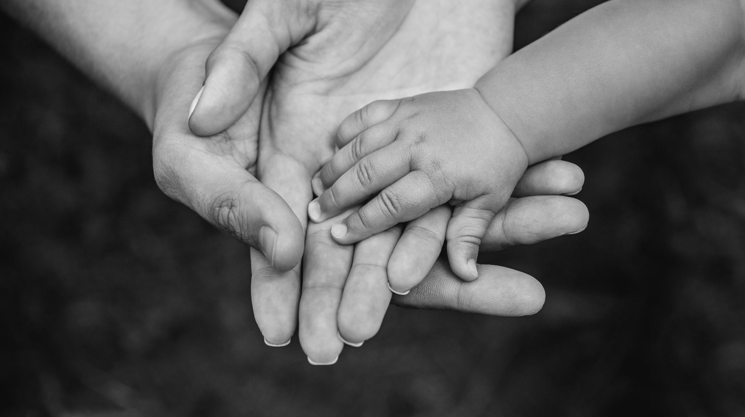
Welcome a Little Child
(Luke 9:47-48a)
Jesus … took a little child and had him stand beside Him.
Then He said to them, “Whoever welcomes this little child in My name welcomes Me ….”
Jesus … took a little child and had him stand beside him. Then he said to them, “Whoever welcomes this little child in my name welcomes me ….”

Slide 6
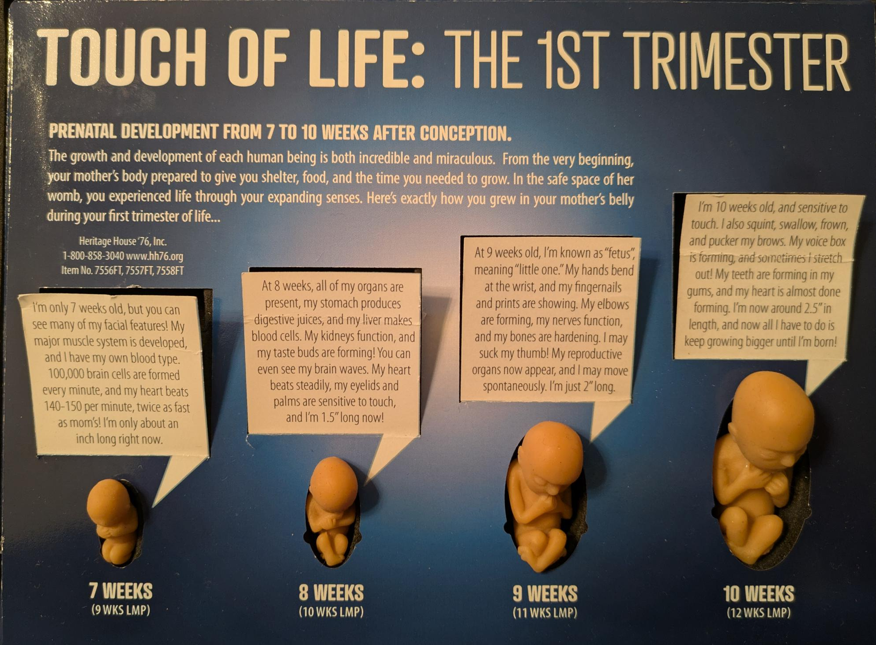
Baby Olivia (beginning at week 7) babyolivia.com

Slide 7


Slide 8
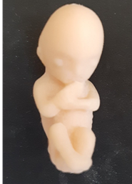
8-Week Preborn
Our arms, hands, fingers, feet and toes were fully formed.
Our hearts had already been beating for 5 weeks.
We had our own blood and DNA completely separate from our mothers.

Slide 9
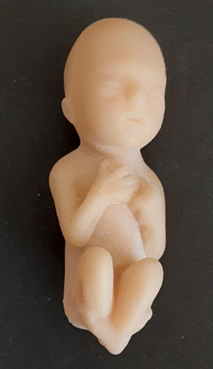
10-Week Preborn
We’d grown so much!
All our organs, limbs, bones and muscles were present and developing more every day.
We could suck our thumbs.
All our fingers were developing fingerprints.
We were practicing breathing to get ready for when we got to see our moms face to face!

Slide 10
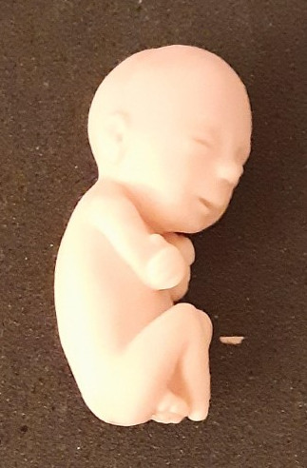
12-Week Preborn
Our fingers had fingernails with tiny developing fingerprints.
Our eyes had their first coloring.
We could make facial expressions and even smile.

Slide 11

God Made Us
(Psalm 139:13-14)
You made my whole being. You formed me in my mother’s body.
I praise You because You made me in an amazing and wonderful way.
What You have done is wonderful. I know this very well.

Slide 12
God Made Us
(Psalm 139:15-16)
You saw my bones being formed as I took shape in my mother’s body.
When I was put together there,
You saw my body as it was formed.
All the days planned for me were written in Your book before I was one day old.

Slide 13
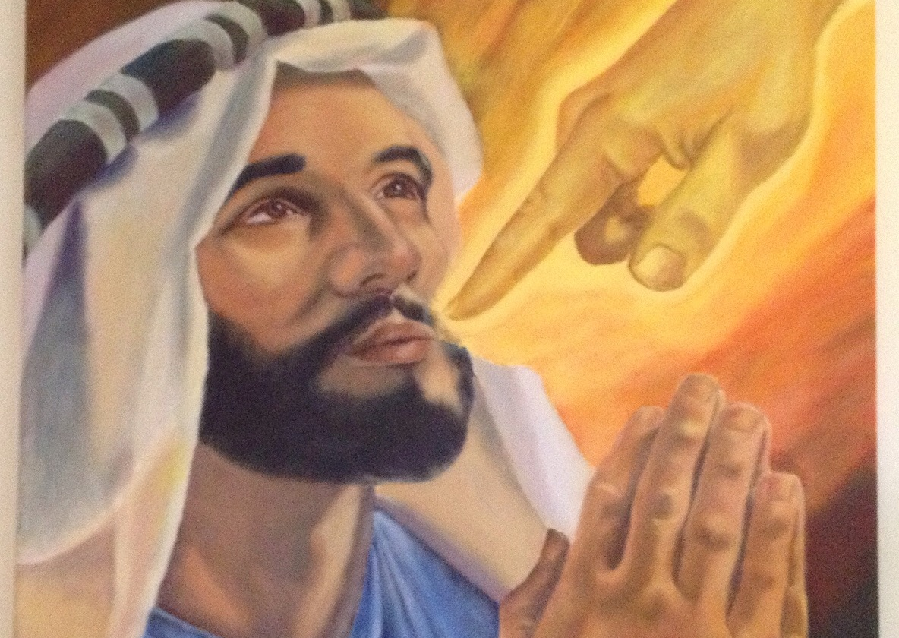
God Calls Jeremiah (Jeremiah 1:4-5)
The Lord spoke these words to me:
“Before I made you in your mother’s womb, I chose you.
Before you were born, I set you apart for a special work.
I appointed you as a prophet to the nations.”

Slide 14
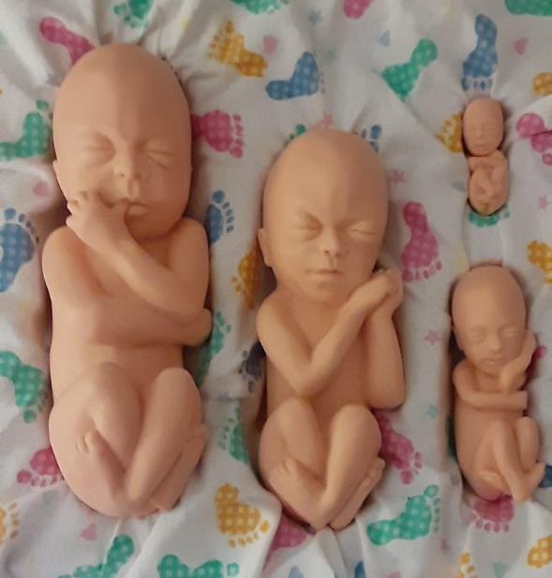
PREBORN
BABY
DOLLS
12 Weeks
16 Weeks
26 Weeks
22 Weeks

Slide 15
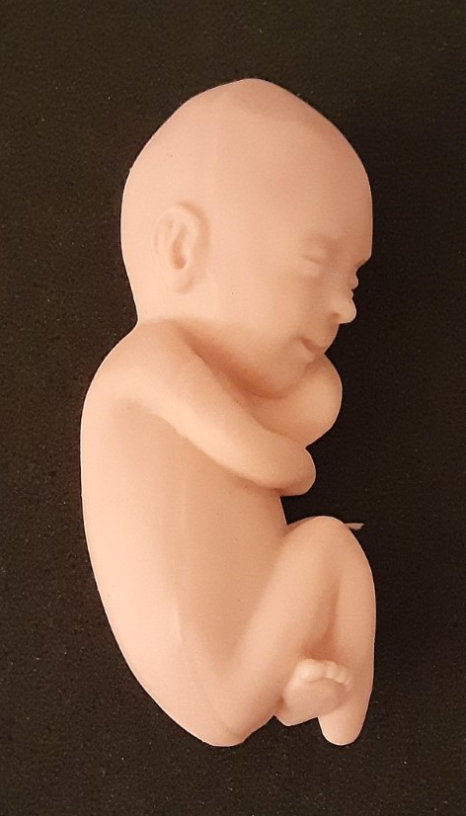
16-Week Preborn
We were active.
We may have sucked our thumbs, turned somersaults and had a firm grip.
We began to develop sleeping habits.

Slide 16
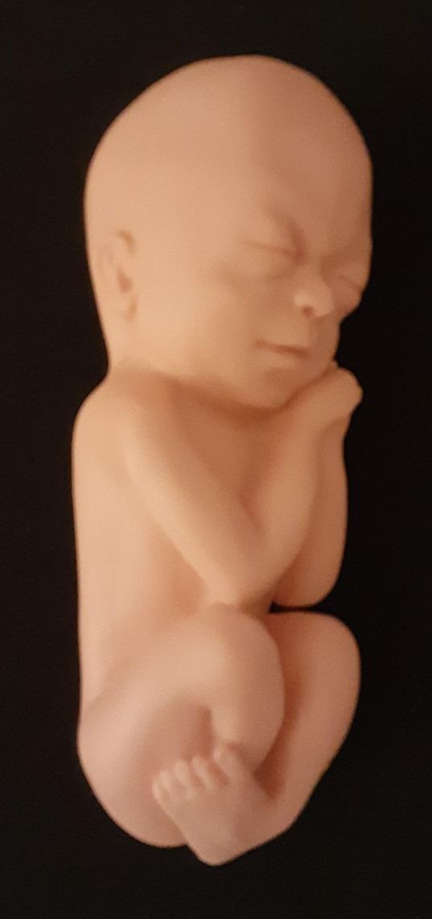
22-Week Preborn
Our mothers may have felt us kick or hiccup.
Our brains were very developed.

Slide 17
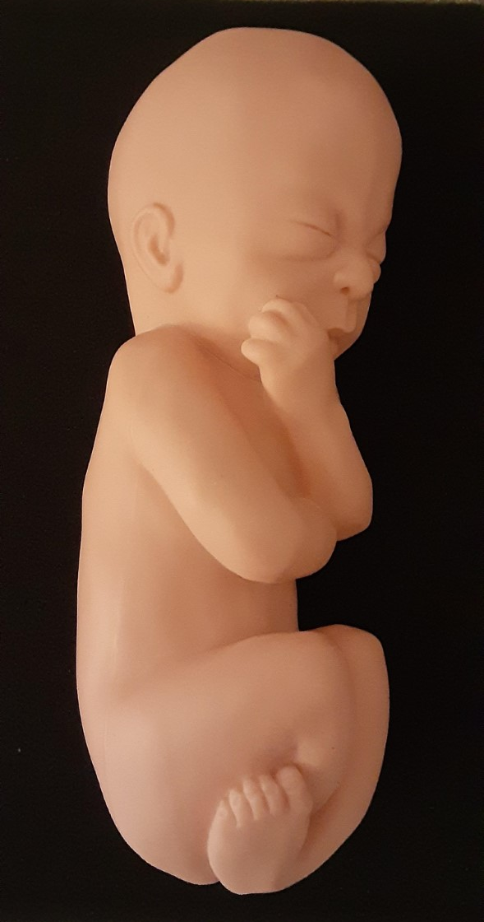
26-Week Preborn
We were able to hear.
We slept and woke up.
In two weeks, our eyelids began to open, preparing to see the outside world.

Slide 18
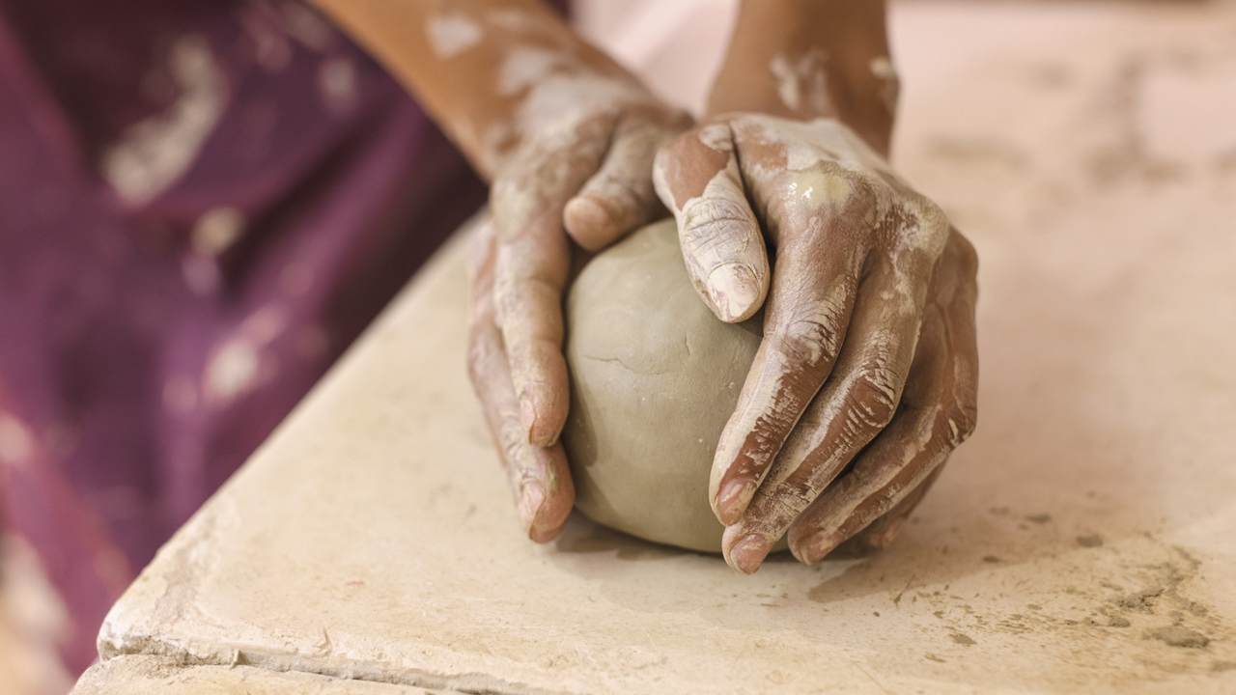
Children Are Made in God’s Image
(Genesis 1:26a)
Then God said,
“Let Us make human beings in Our image and likeness.”

Slide 19
We are in the image of God, our Maker, in these ways:

Slide 20

  Mentally
  We can reason and choose.

Slide 21

  Morally
  We have a conscience.

Slide 22

  Socially
  We can fellowship with God and others.

Slide 23
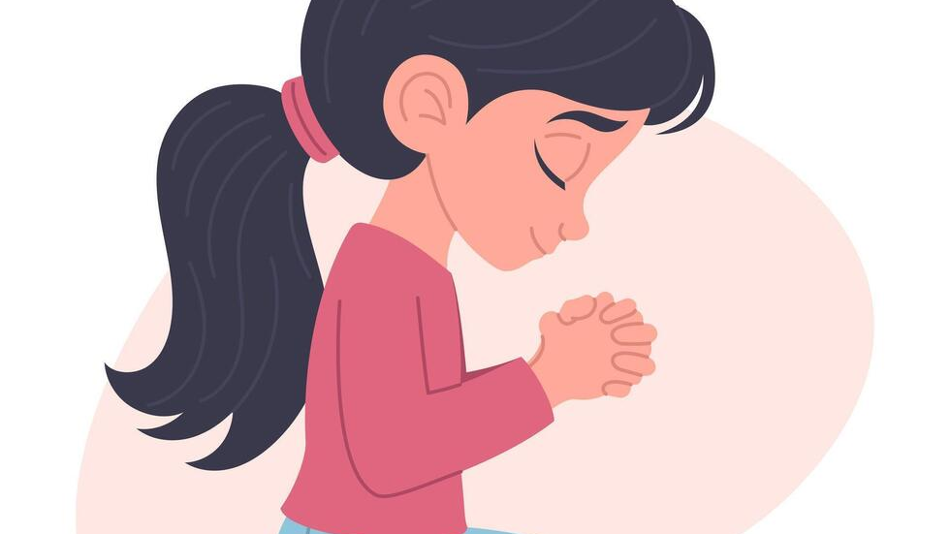
  Spiritually
  We have an eternal soul.

Slide 24
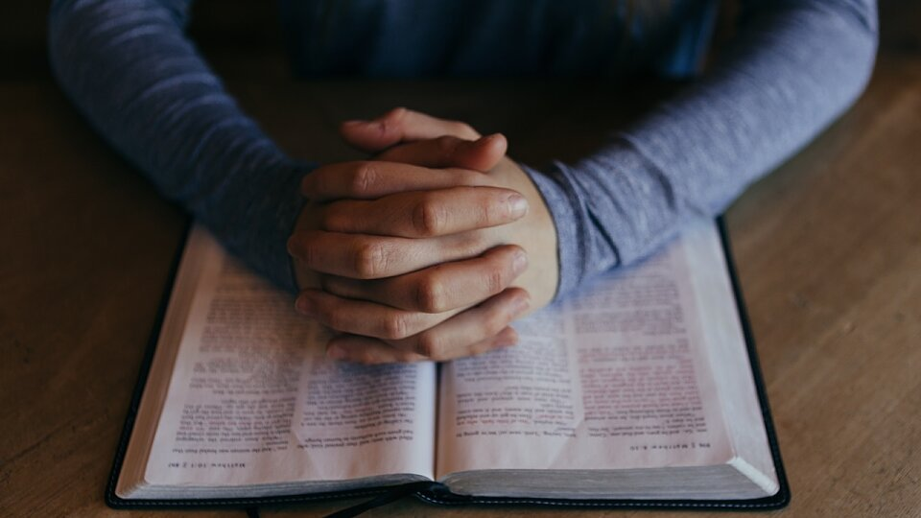
Spirituality
We are the only creatures who can have a spiritual relationship with God.
God gave human beings a soul that makes this possible.

Slide 25
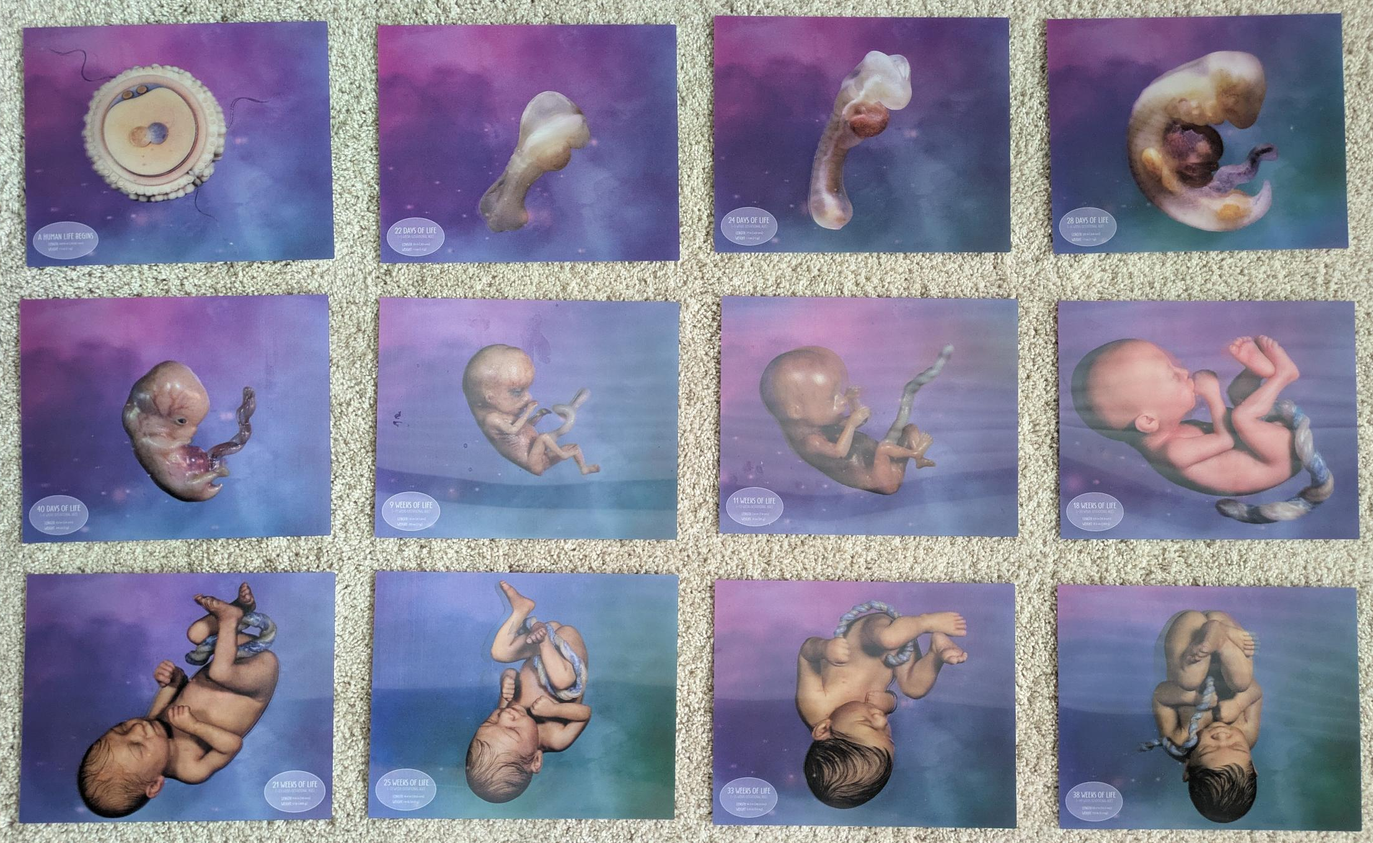

Slide 26
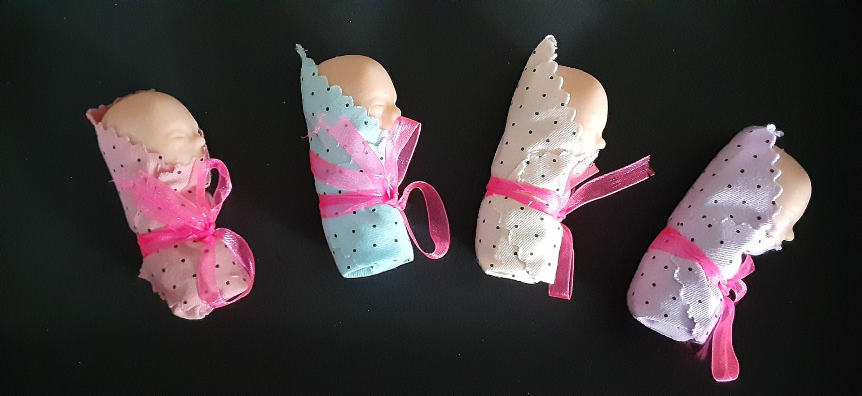
Preborn Remembrance
12-Week Preborn

Slide 27
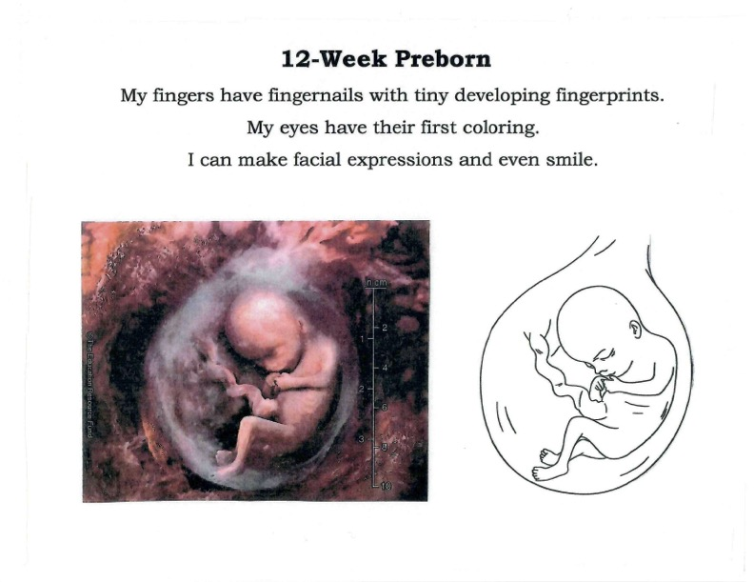

Slide 28
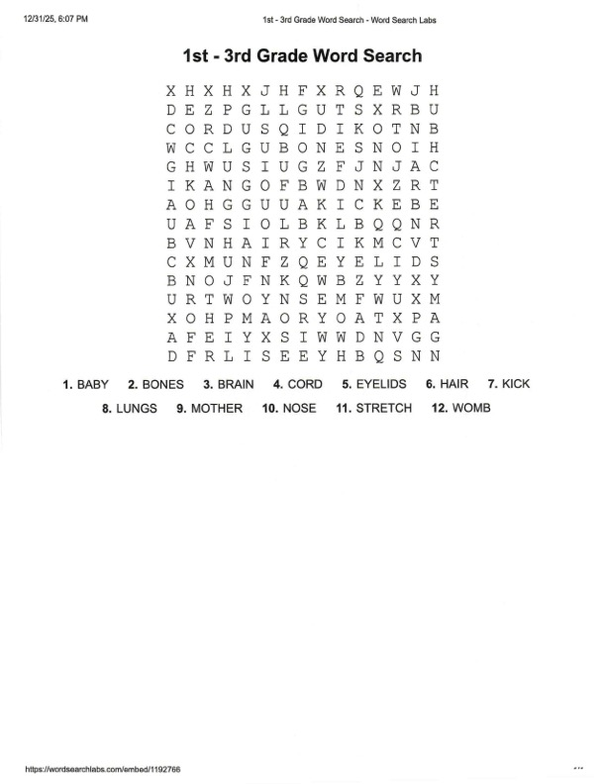
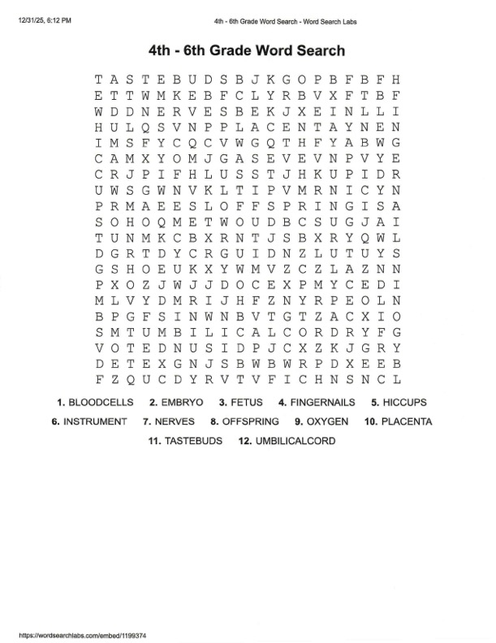

Slide 29
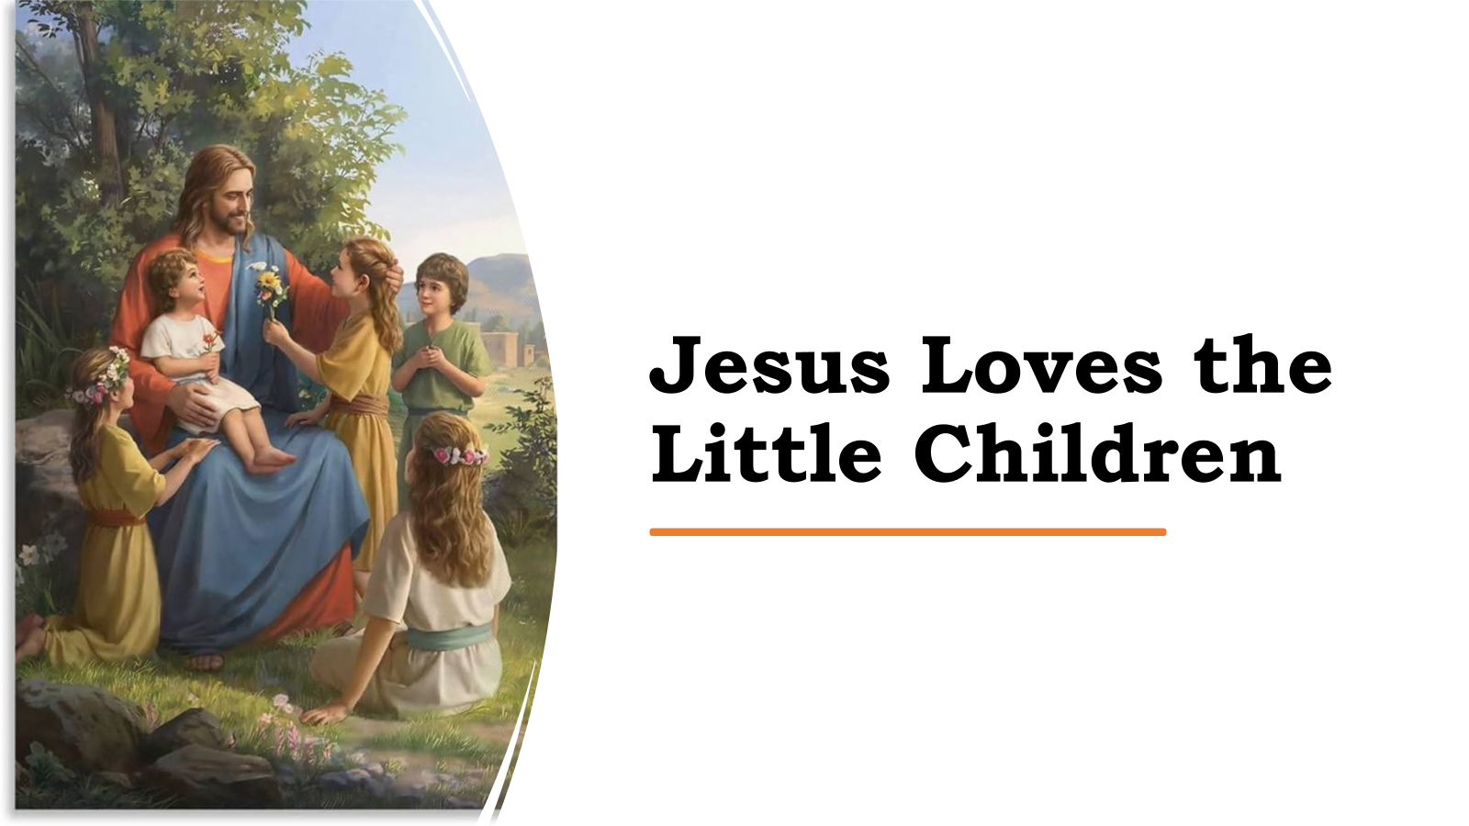

Slide 33
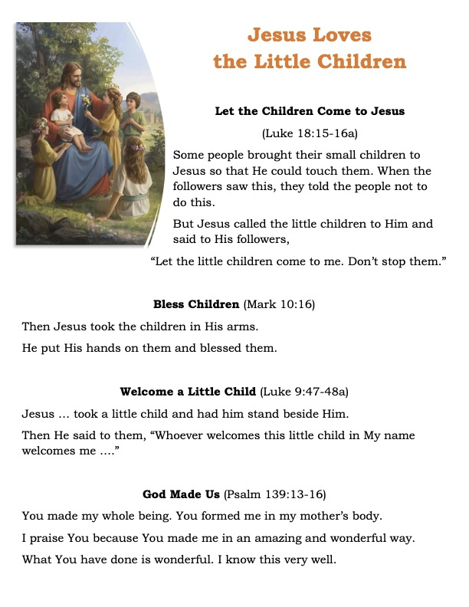

Slide 34
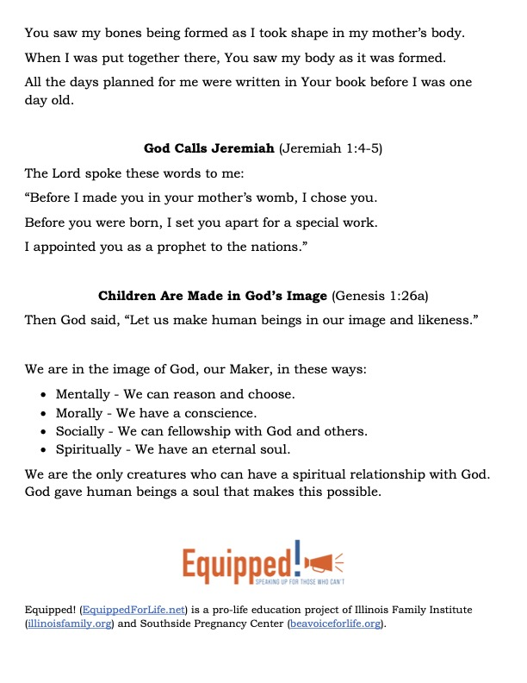

Slide 35
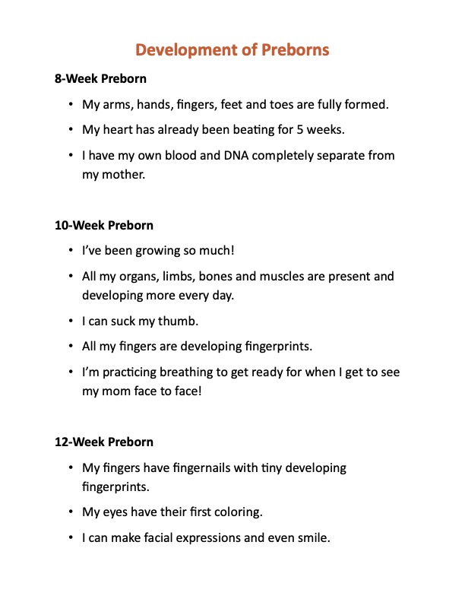

Slide 36
